Slide 1
Bootcamp
Python for Data Science

Slide 2
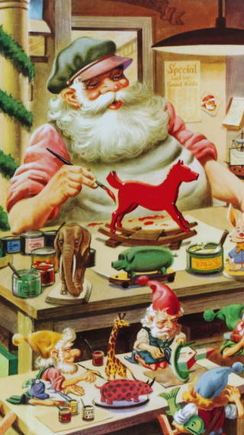
Functions
Defining your own

Slide 3

Defining a Function
Reusable chunk of code

Slide 4
Defining a Function
Reusable chunk of code
Build action from basic functions

Slide 5
Defining A Function
def double(my_name):
answer = my_name + my_name
return answer

Slide 6
Defining A Function
def double(my_name):
answer = my_name + my_name
return answer

Slide 7
Defining A Function
def double(my_name):
answer = my_name + my_name
return answer

Slide 8
Defining A Function
def double(my_name):
answer = my_name + my_name
return answer
arbitrary label for input

Slide 9
Defining A Function
colon
def double(my_name):
answer = my_name + my_name
return answer

Slide 10
Defining A Function
def double(my_name):
answer = my_name + my_name
return answer

Slide 11
Defining A Function
def double(my_name):
answer = my_name + my_name
return answer
indented block

Slide 12
Defining A Function
def double(my_name):
answer = my_name + my_name
return answer

Slide 13
Calling A Function
double(“Rob”)

Slide 14
Calling A Function
def double(“Rob”):
answer = “Rob” + “Rob”
return answer

Slide 15
Calling A Function
double(“Rob”)
no space

Slide 16
Exercises

Slide 17

Debugging
Let’s talk about

Slide 18
Default Debugging strategy
https://tenor.com/view/office-anger-rage-quit-stressed-gif-11148457

Slide 19
three types of Bugs
Syntactic: Code won’t run
Runtime: Code stops with error
Semantic: Runs, but wrong output

Slide 20
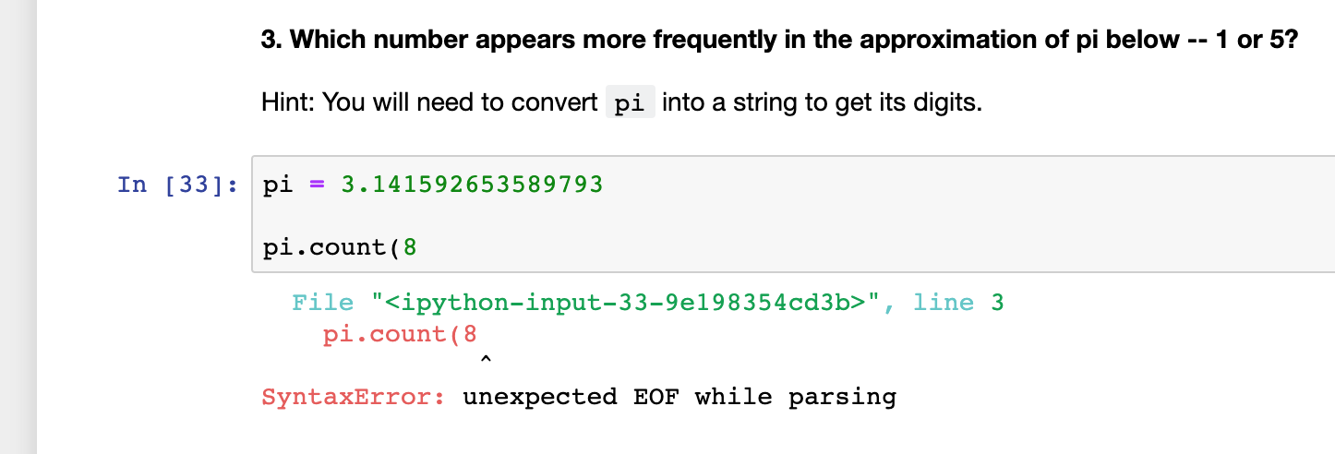
Solving Syntactic Bugs

Slide 21
Solving Syntactic Bugs
Find line number in error

Slide 22
Solving Syntactic Bugs
Find line number in error
Compare your code with recipe

Slide 23
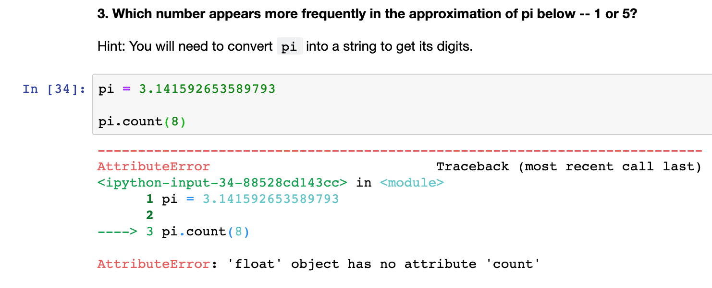
Solving Runtime Bugs

Slide 24
Solving Runtime Bugs
*Double check your data types*

Slide 25
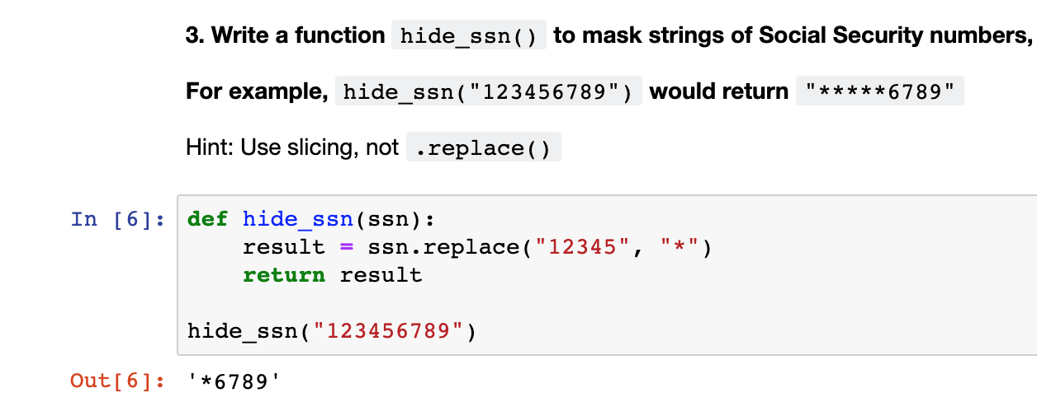
Solving semantic Bugs

Slide 26
Print function
English:
Print value of my_name on the screen

Slide 27
Print Function
English:
Print my_name on the screen

Slide 28
print function
print(my_name)

Slide 29
print function
print(my_name)
“Rob”

Slide 30
print function
print(my_name)
“Rob”
______

Slide 31
Solving semantic Bugs
Print variables halfway through code

Slide 32
Solving semantic Bugs
Print variables halfway through code
Compare outputs with expected values

Slide 33
Solving semantic Bugs
Print variables halfway through code
Compare outputs with expected values
Something weird? Then repeat halfway up your code. Else go halfway down.

Slide 40


Slide 41
Concepts covered so Far
Syntactic errors
Runtime errors
Semantic errors
print()

Slide 42
Exercises

Slide 43
List
Ordered
No set length or data type

Slide 44
List: Basic usage
my_list = [1, “two”, 3.0]

Slide 45
List: Basic usage
my_list = [1, “two”, 3.0]
list literal

Slide 46
Append
my_list.append(“new thing”)

Slide 47
Append
my_list.append(“new thing”)
_______

Slide 48
List
Mutable
Some methods return no value!

Slide 49
Strings
Immutable
Methods always return new string

Slide 50
Numbers
Immutable
Methods always return new string

Slide 51
List: Basic usage
my_list.append(“new thing”)
print(my_list)

Slide 52
List: Basic usage
my_list.append(“new thing”)
print(my_list)
[1, “two”, 3.0, “new thing”]

Slide 53
Assigning to an index
my_list[0] = “new thing”

Slide 54
Assigning to an Index
my_list[0] = “new thing”
_______

Slide 55
Assigning to an Index
my_string[0] = “?”

Slide 56
Assigning to an Index
my_string[0] = “?”
No! Immutable!

Slide 57
List: Basic usage
last_item = my_list.pop()

Slide 58
List: Basic usage
last_item = my_list.pop()
“new thing”

Slide 59
List: Basic usage
last_item = my_list.pop()
print(my_list)
[1, “two”, 3.0]

Slide 60
List: Basic usage
first_item = my_list.pop(0)

Slide 61
List: Basic usage
first_item = my_list.pop(0)
1

Slide 62
Concepts covered so Far
Lists
Mutability
No return value

Slide 63
Exercises

Slide 64
Sequences
Strings
Lists

Slide 65
StringS: Same
Same index and slice syntax!

Slide 66
StringS: but Different
Cannot add or remove characters

Slide 67
Exercises

Slide 68
String methods: Split & join
Translate between list/string
Use a string as glue/delimiter

Slide 69
Split
“a new string”.split()

Slide 70
Split
“a new string”.split()
[“a”, “new”, “string”]

Slide 71
Split
“id, name, date”.split(“,”)

Slide 72
Split
“id, name, date”.split(“,”)
[“id”, “name”, “date”]

Slide 73
Join
“,”.join([“id”, “name”, “date”])
“id, name, date”

Slide 74
Join
“|”.join([“id”, “name”, “date”])
“id|name|date”

Slide 75
Split & join methods
Translate between list/string
Use a string as glue/delimiter

Slide 76
Two more methods
len() —> find length of sequence
sorted() —> return sorted version

Slide 77
Concepts covered so Far
.split() method
.join() method
len() function
sorted() function

Slide 78
Values: What kinds are there?
Int
Float
String
?

Slide 79
Equals
“this str” == “that str”

Slide 80
Booleans
100 > 0
“this str” == “that str”

Slide 81
Booleans
100 > 0
“this str” == “that str”
True
False

Slide 82
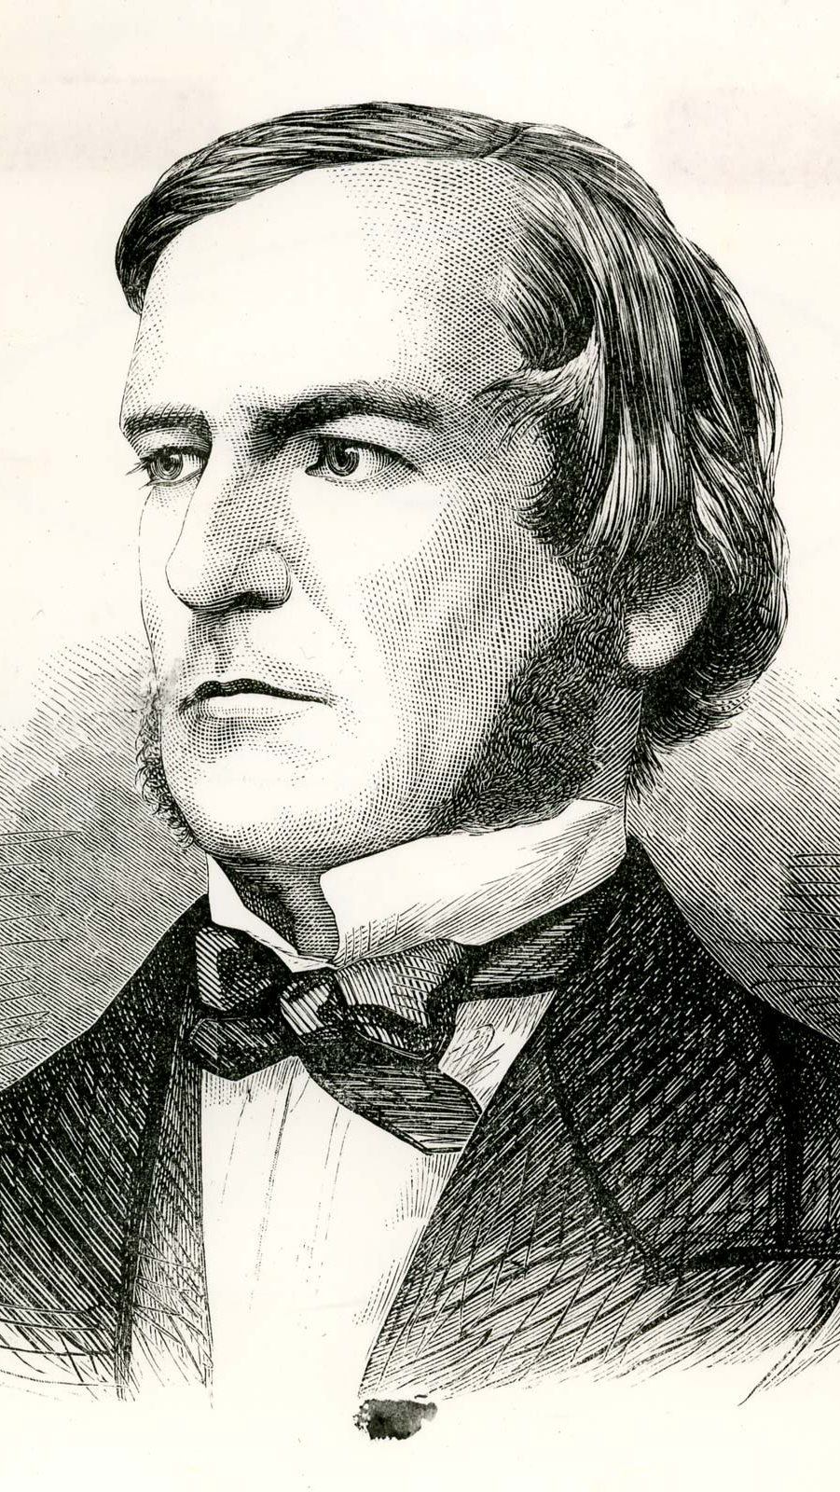
“universal laws of thought which are …mathematical as to their form”
George Boole

Slide 83
Boolean Operators?
True + False
True * False
True / True

Slide 84
Boolean Operators?
True + False
True * False
True / True

Slide 85
Boolean Operators
or
and
not

Slide 86
Boolean Operators
True or False
True and False
not True

Slide 87
Boolean Operators
True or False
True and False
not True
True

Slide 88
Boolean Operators
True or False
True and False
not True
True
False

Slide 89
Boolean Operators
True or False
True and False
not True
True
False
False

Slide 90
Values: What kinds ARE THERE?
Int
Float
String
Bool

Slide 91
Casting between Data types
int()
float()
str()
bool()

Slide 92
Concepts covered so Far
Boolean values (True/False)
Boolean operators (or, and, not)
Casting between data types

Slide 93
Exercises

Slide 94
Concepts covered so Far
Boolean values (True/False)
Boolean operators (or, and, not)
Casting between data types

Slide 95
What’s missing?

Slide 96
Flow Diagram
Start
Finish

Slide 97


Slide 98
Conditional Statements
Directs route taken by program
Hinges on Boolean expressions

Slide 99
Examples of conditions
my_name == “Rob”
age > 21
name in list_of_guests

Slide 100
if Statement
if condition_is_true:
print(“extra code runs!”)

Slide 101
Flow Diagram
Extra!
Yes
Start
If
No
Finish

Slide 102
if-Else Statement
if condition_is_true:
print(“path #1 runs”)
else:
print(“path #2 runs”)

Slide 103
Flow Diagram
Path 1
Yes
Start
If
Finish
No
Path 2

Slide 104
if-elif-Else Statement
if condition_is_true:
print(“path #1 runs”)
elif second_condition_is_true:
print(“path #2 runs”)
else:
print(“path #3 runs”)

Slide 105
Flow Diagram

Slide 106
Flow Diagram

Slide 107
Conditional Statements
Directs route taken by program
Hinges on Boolean expressions

Slide 108
Exercises

Slide 109
For-Loops
Repeats a chunk of code
Hands in different item each time

Slide 110
For-loops
pets = [“dog”, “cat”, “fish”]
for pet in pets:
print(pet)

Slide 111
For-loops
pets = [“dog”, “cat”, “fish”]
for pet in pets:
if pet == “dog”:
print(“Man’s best friend!”)
else:
print(“whatever”)

Slide 112
Range function
Generates range of numbers
Parameters match slice syntax

Slide 113
Range function
range(3)

Slide 114
Range function
range(3)
0, 1, 2

Slide 115
Range function
range(1,4)

Slide 116
Range function
range(1,4)
1, 2, 3

Slide 117
Range function
range(3,0,-1)
3, 2, 1

Slide 118
Range is Not A List
Returns a “lazy” list
Numbers are generated one-by-one to save memory

Slide 119
Convert Range to list
list(range(3))
[0, 1, 2]

Slide 120
For-Loops
Repeats a chunk of code
Hands in different item each time

Slide 121
Exercises

